Slide 1
Lecture 2

Slide 2
Elements of a C++ Program
Assignment statement
Output statement
Input statement
Return Statement
Comments
Keywords
Variables
Literals
Semicolons and Brackets

Slide 3
Preprocessor
directive
Variable
initialization
#include <iostream>
int main()
{
int x=0,num=0;
cout<<”Enter a number”<<endl;
cin >>num;
x = 100+num; //Addition of two numbers
cout<<x<<endl;
return 0;
}
Keywords
Variables
X
num
int, cout, endl,cin, return
Input
statement
String literal
“Enter a number”
Assignment
statement
Comment
Output
statement
Return statement

Slide 4
C++ is case sensitive
// sample C++ program
#Include <Iostream>
Int Main() {
cout << “Hello World!”;
return 0;
}

Slide 5
Assignment Operator
The most common form of statements in C++ is an assignment statement
An assignment statement has the following form
LHS = RHS;
This is NOT an equation!
The = in the middle is the ASSIGNMENT OPERATOR
An assignment statement performs the following task
Evaluate the RHS and assign that value to whatever is on the LHS

Slide 6
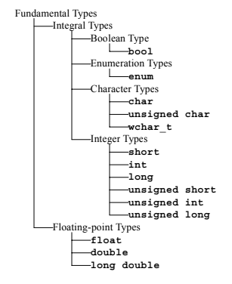
Data Types

Slide 7
Literals
int x = 17;
float pi = 3.142;
char c = ‘c’;
string fruit = “Apple and Oranges”;
bool b = True/False;
https://www.tutorialspoint.com/cplusplus/cpp_constants_literals.htm

Slide 8
Identifier
A valid identifier is a sequence of one or more letters, digits, or underscore characters (_).
Spaces, punctuation marks, and symbols cannot be part of an identifier.
Identifiers shall always begin with a letter. They can also begin with an underline character (_), but such identifiers are -on most cases- considered reserved for compiler-specific keywords or external identifiers.

Slide 9
Variables
Avoid using keywords.
Avoid using punctuations.(!@#$%)
Avoid using numbers at the beginning.
(e.g: avoid using 1x,2x, use x1,x2)
Be consistent with your style in a project.

Slide 10
C++ Keyword
Several words in C++ have been reserved by the author
These reserved words are called keywords
They all have special meaning in C++ and can only be used for their intended purpose
Using a keyword where its not meant to be used will result in a compile-time error

Slide 11
C++ Keyword
asm | auto | break | bool | case
catch | char | class | const | const_cast
continue | default | delete | do | double
dynamic_cast | else | enum | explicit | extern
false | float | for | friend | goto
if | inline | int | long | mutable
namespace | new | operator | private | protected
public | register | reinterpret_cast | return | short
signed | sizeof | static | static_cast | struct
switch | template | this | throw | true
try | typedef | typeid | typename | union
unsigned | using | virtual | void | volatile
wchar_t | while

Slide 12
Special Characters
Character | Name | Meaning
// | Double slash | Beginning of a comment
# | Pound sign | Beginning of preprocessor directive
< > | Open/close brackets | Enclose filename in #include
( ) | Open/close parentheses | Used when naming a function
{ } | Open/close brace | Encloses a group of statements
" " | Open/close quotation marks | Encloses string of characters
‘ ’ | Open/close single quotation marks | Encloses a single character
; | Semicolon | End of a programming statement

